Slide 1

Final Project Final Video Project Title - Eye Cataract Glaucoma Retina-Disease Classifier
By [Team 17] Team Members
Md Farhamdur Reza (PhD in Electrical Engineering)
Pramodini Karwande (Master in Statistics)
Rageeni Sah (M.S. in Electrical Engineering)

Slide 2

Motivation
Eye diseases like cataract, glaucoma, and retina diseases are prevalent in the present world and causing more of blindness among people.
It is required to have a highly trained eye specialist to detect the eye diseases, and for a layperson, it sometimes becomes difficult to carry the expense.

Slide 3
Problem Statement
To model multi-class classifier that can predict the eye condition given an eye image
Baseline/Existing classifier [classical models (LR, GB, RF & SVM)]
We propose a neural network-based classifier with better performance
Normal
Cataract
Classes
Glaucoma
Retina disease

Slide 4
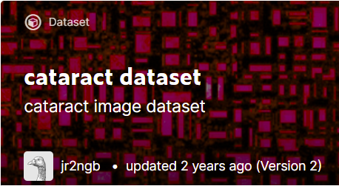
Dataset
Dataset is available on Kaggle - https://www.kaggle.com/jr2ngb/cataractdataset
Total images – 601
Images dimension is width = 300 pixels and height = 200 pixels
Key data challenges
Less data - There are just 601 images which is less for neural networks
Imbalanced classes (count of normal images is 3 times higher than other classes)
Images have varying illumination
Class | Number of Images
Cataract | 100
Glaucoma | 101
Normal | 300
Retina-disease | 100

Slide 5
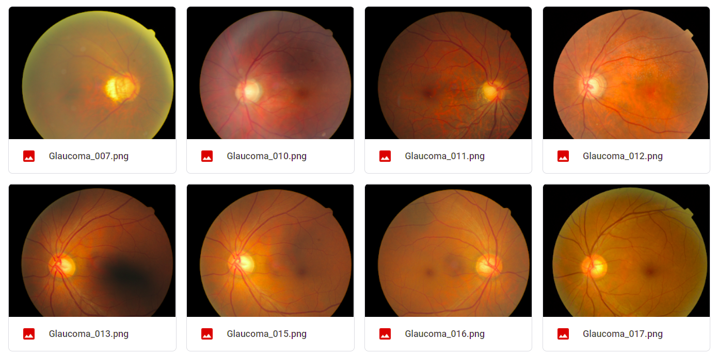
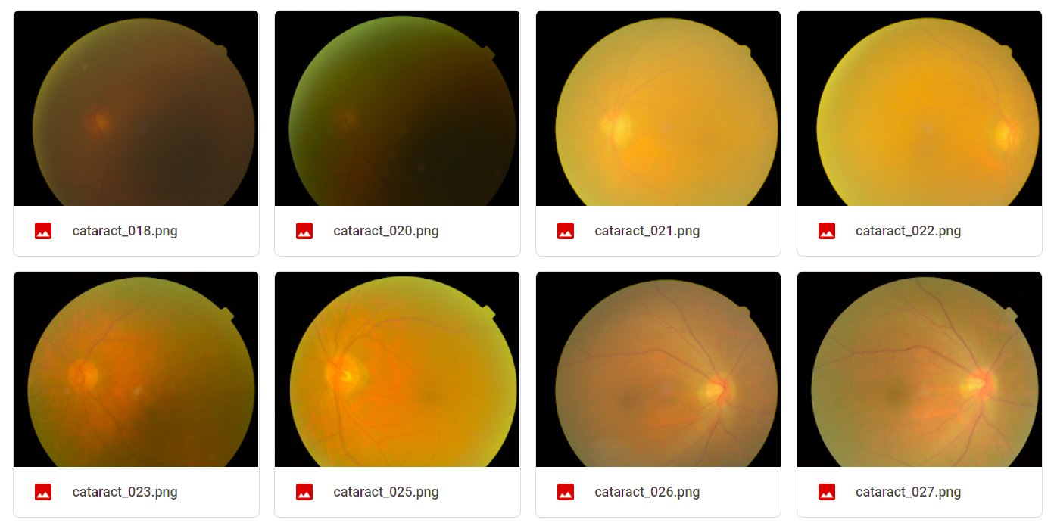
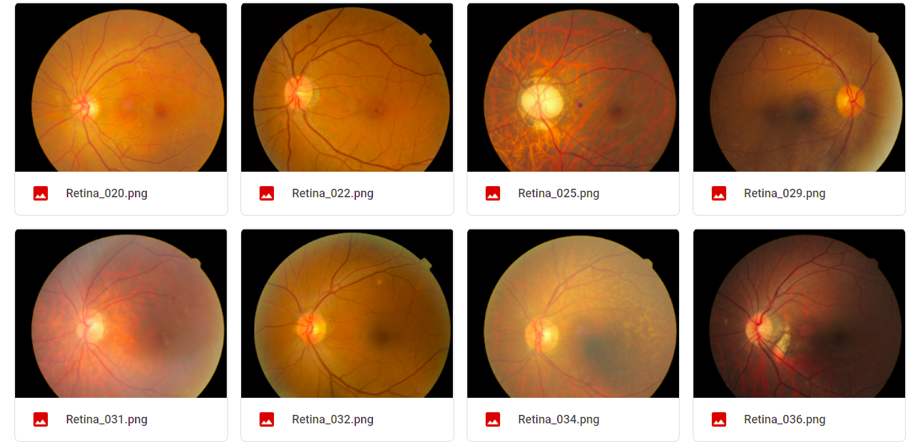
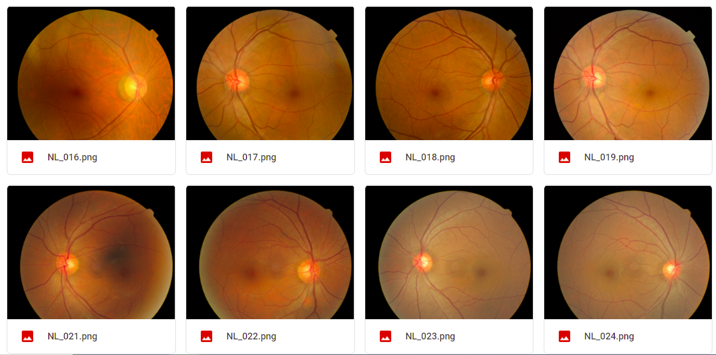

Slide 6
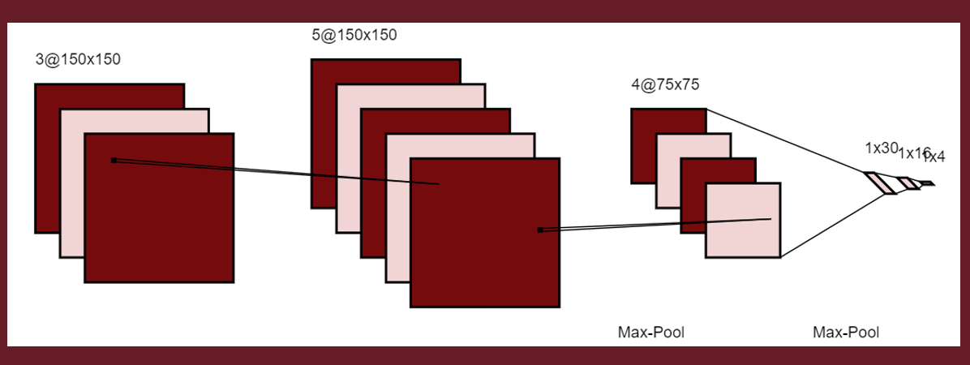
Model Training
Two-dimension Convolution Neural Network used for training
Training and validation
Data split into training and validation sets in ratio of 7:3
Images are resized to 150X150 pixels
Performance Metrics – Accuracy and f1-score

Slide 7
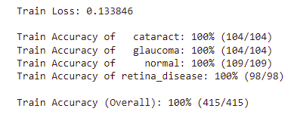
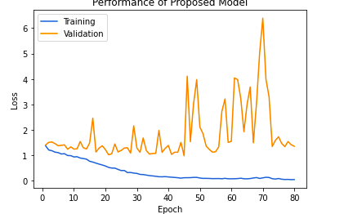
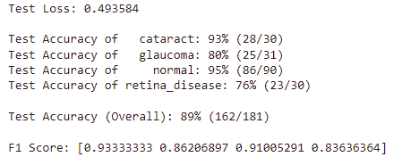
Result Summary
Training Metrics
Training and Validation Loss
Validation Metrics

Slide 8
Results Comparison
 | Models | Training Accuracy | Validation Accuracy
Baseline Model | Logistic Regression | 0.616 | 0.618
 | Random Forest | 0.604 | 0.607
 | Gradient Boosting | 0.690 | 0.646
 | Support Vector Machine | 0.531 | 0.569
Proposed Model (Initial Round) | CNN2D (batch size = 100, epoch = 80, optimizer – ADAM with default lr, batchNorm) | 0.960 | 0.560
Proposed Model (Final Round) | CNN2D (batch size = 100, epoch = 80, optimizer – ADAM with default lr, batchNorm, L2-Regularization) | 1.000 | 0.890

Slide 9
Scope of Improvements
Hyper-parameter tunings
Overfitting handling
Generating additional data
Data Augmentation using generative models such as AE and GAN

Slide 10

End

